Slide 1

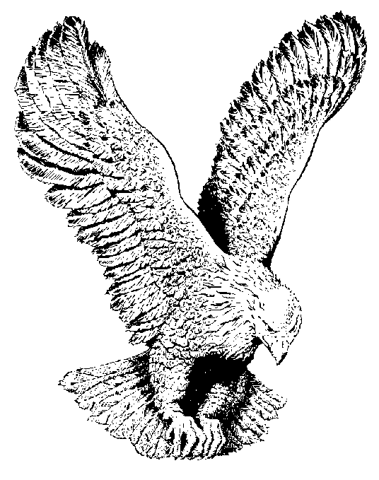
I’M GOING UP
I’m going up, I’m going up
I’m going up in the first resurrection.
I’m going up, I’m going up
I’m going up to meet the Lord.
They’ll be coming from the East,
Coming from the west,
Coming from the North,
They’ll be coming from the South.
I’m going up, I’m going up
I’m going up to meet the Lord.

